Slide 1
Table of contents
Objective
Introduction
Overall work plan/Flow chart of the project in diagram form
Module of the project
Sample Output screen
References

Slide 2
Objectives of the study
. This project mainly explains the various actions related to student details. This project shows some ease in adding, editing and deleting the student details. It also provides a less time consuming process for viewing, adding, editing and deleting the marks of the students.
. A student information system (SIS), student management system, school administration software or student administration system is a management information system for education sector establishments used to manage student data. It integrates students, parents, teachers and the administration.

Slide 3
INTRODUCTION
. Student Management System is software which is helpful for students as well as the school authorities. In the current system all the activities are done manually. It is very time consuming and costly. Our Student Management System deals with the various activities related to the students.
There are mainly 3 modules in this software•
->User module•
->Student Module•
->Mark managementModule.
.In the Software we can register as a user and user has of two types, student and administrator. Administrator has the power to add new user and can edit and delete a user. A student can register as user and can add edit and delete his profile. The administrator can add edit and delete marks for the student. All the users can see the marks.

Slide 4
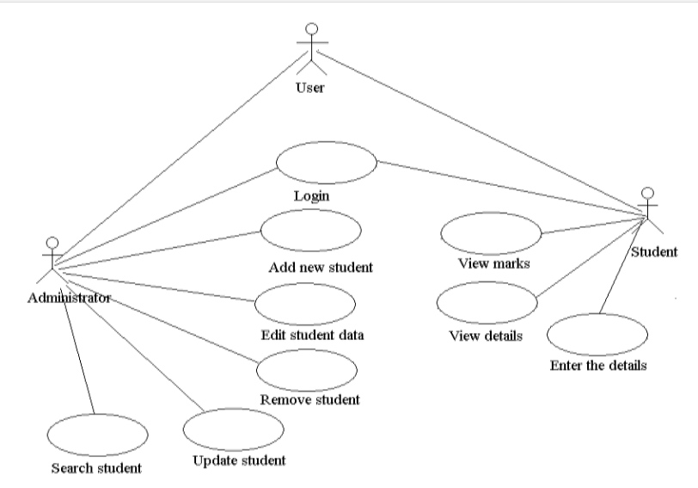
Flow chart/DFD of the study

Slide 5
PYTHON
Python is an interpreted, object-oriented, high-level programming language with dynamic semantics. Its high-level built in data structures, combined with dynamic typing and dynamic binding, make it very attractive for Rapid Application Development, as well as for use as a scripting or glue language to connect existing components together. Python supports modules and packages, which encourages program modularity and code reuse. The Python interpreter and the extensive standard library are available in source or binary form without charge for all major platforms, and can be freely distributed.
Tkinter is a Python binding to the Tk GUI toolkit. It is the standard Python interface to the Tk GUI toolkit, and is Python's de facto standard GUI. Tkinter is included with standard Linux, Microsoft Windows and macOS installs of Python. A window which acts as a child of the primary window. It will be decorated with the standard frame and controls for the desktop manager. It can be moved around the desktop and can usually be resized.
Widget-
The generic term for any of the building blocks that make up an application in a graphical user interface.
Core widgets: The containers: frame, labelframe, toplevel, paned window. The buttons: button, radiobutton, checkbutton (checkbox), and menubutton. The text widgets: label, message, text. The entry widgets: scale, scrollbar, listbox, slider, spinbox, entry (singleline), optionmenu, text (multiline), and canvas.

Slide 6
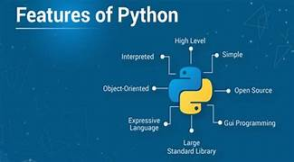
Tkinter provides three modules that allow pop-up dialogs to be displayed: tk.messagebox (confirmation, information, warning and error dialogs), tk.filedialog (single file, multiple file and directory selection dialogs) and tk.colorchooser (colour picker).
Frame- In Tkinter, the Frame widget is the basic unit of organization for complex layouts. A frame is a rectangular area that can contain other widgets.
Child and parent- When any widget is created, a parent–child relationship is created. For example, if you place a text label inside a frame, the frame is the parent of the label.
Process - There are four stages to creating a widget.
Create- create it within a frame
Configure- change the widgets attributes.

Slide 7
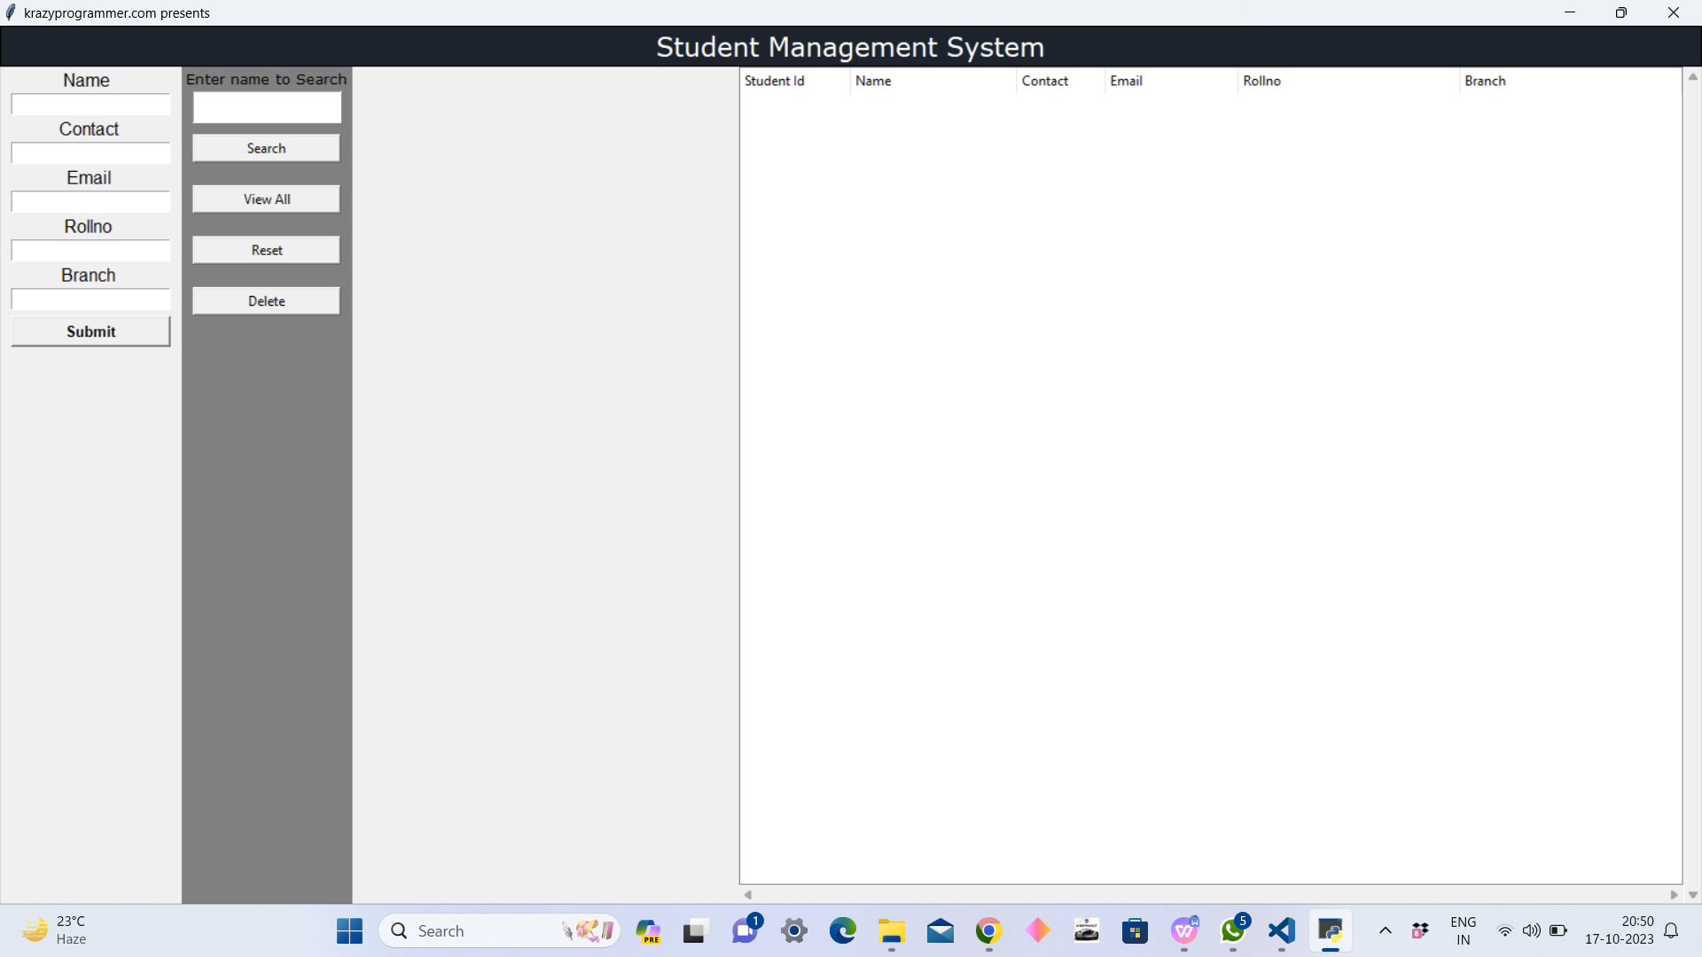
OUTPUT SCREEN

Slide 8
REFERENCES
https://studylib.net/doc/25593734/student-management-system
https://en.wikipedia.org/wiki/Student_information_system
https://www.geeksforgeeks.org/student-management-system-in-python/

